Slide 1

Machine Learning for Cyber Security
Mesut GUVEN, Ph.D.

Slide 2
information
Exams; 55% (Mid 25% + Final 30%), Homeworks; 15%, Project; 30%
In homeworks, you will be expected to examine SCI/E papers (published in last 3 years).
In Final Project, you will implement an AI/ML-based cyber solution.
Textbook:
- Getting Started with Deep Learning: Programming and Methodologies using Python
- Hands-On Machine Learning with Scikit-Learn, Keras, and TensorFlow, 2nd Edition
Code: GitHub
Videos: YouTube

Slide 3
UNIT 2: performance metrics
Learning Outcomes;
- have a better understanding of Traditional ML approaches,
- have a better understanding of features and performance metrics,
- Why we need training, validation and test data sets.

Slide 4
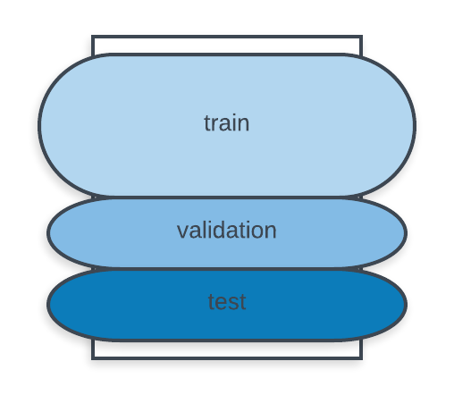
Dataset division
In general, available data is divided into three sub-units, those are respectively; training, validation, and test sets.
Especially, in deep learning algortihms the validation dataset is very important since it provides feedback in training phase and prevents the model to memorize the data (overfitting).
After training, the model’s accuracy is measured by the test dataset. These data samples should be different from training or validation samples and the trained model should see the test data for the first time.
60%
20%
20%

Slide 5
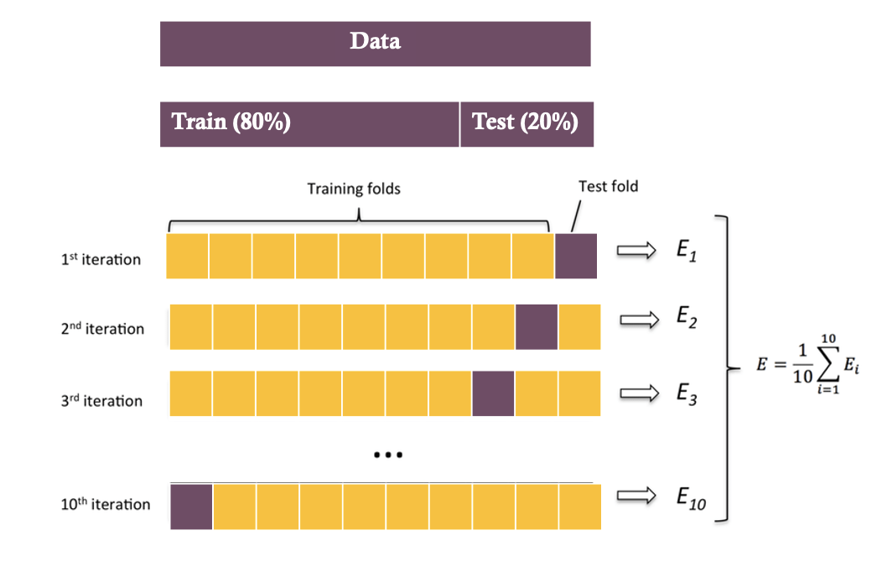
Dataset division
There some methods for dividing the available data into sets.
One of the methods is dividing data into two chunks such as 80% for training and 20% for test/
Another method is k-fold cross validation; “k” represents the partition number here, and in every epoch 9 parts are taken for training and one part is left for test. This is repeated for ”k” times.
Even though this methods increases the computation costs it reduces the bias.

Slide 6
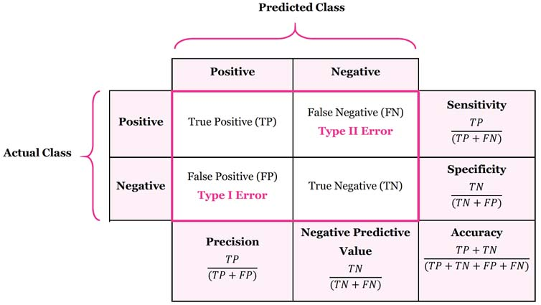
Confusion matrix: accuracy, precision, recall/sensitivity, specificity, f-measure
F-measure = (2 * (precision*recall)) / (precision + recall)

Slide 7
Metrics
These are the common metrics that are used for measuring the how well the trained model performs, respectively;
- Accuracy, Precision, Recall, F-measure, Confusion matrix, ROC curve
The sklearn.metrics module is going to be used for the performance evaluation.
This module can be used with SKlearn classifiers and with Tensorflow classifiers.
Again, this will help to more easily understand deep learning since we don’t have to use the more complex and very verbose Tensorflow functions. This means that Tensorflow code is not complex but rather it is long such as “module_A.module_B.module_C” “sklearn.metrics.confusion_matrix” construction.
We will use accuracy_score, recall_score, f1_score, precision_score, confusion_matrix

Slide 8
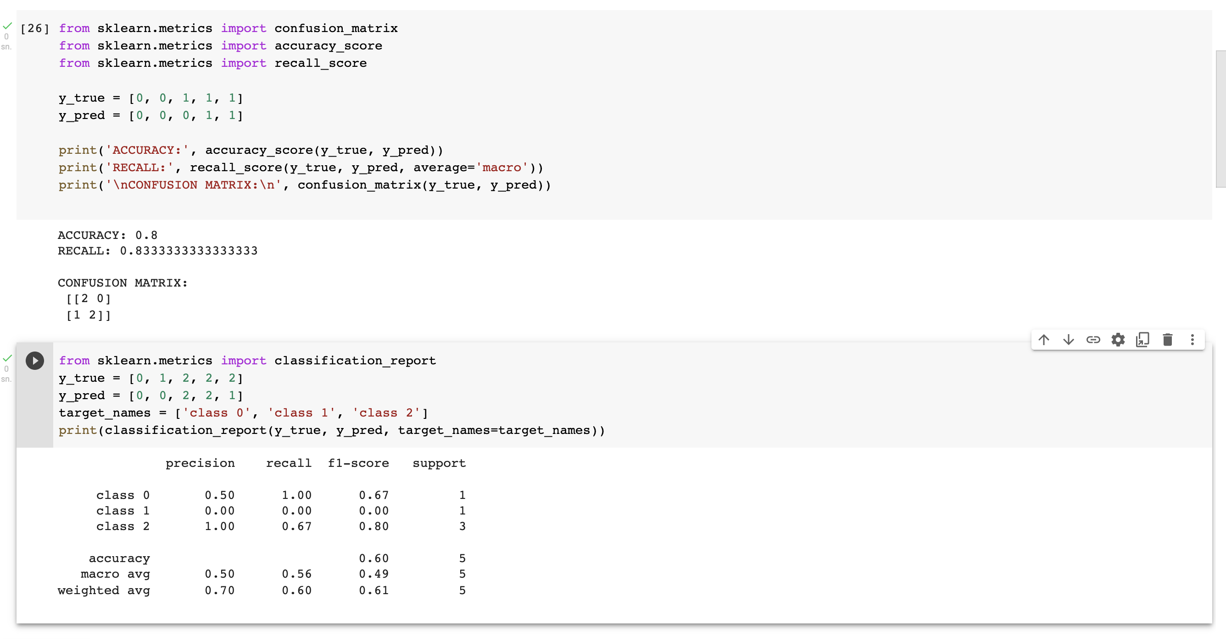
Confusion matrix: accuracy, precision, recall/sensitivity, specificity, f-measure

Slide 9
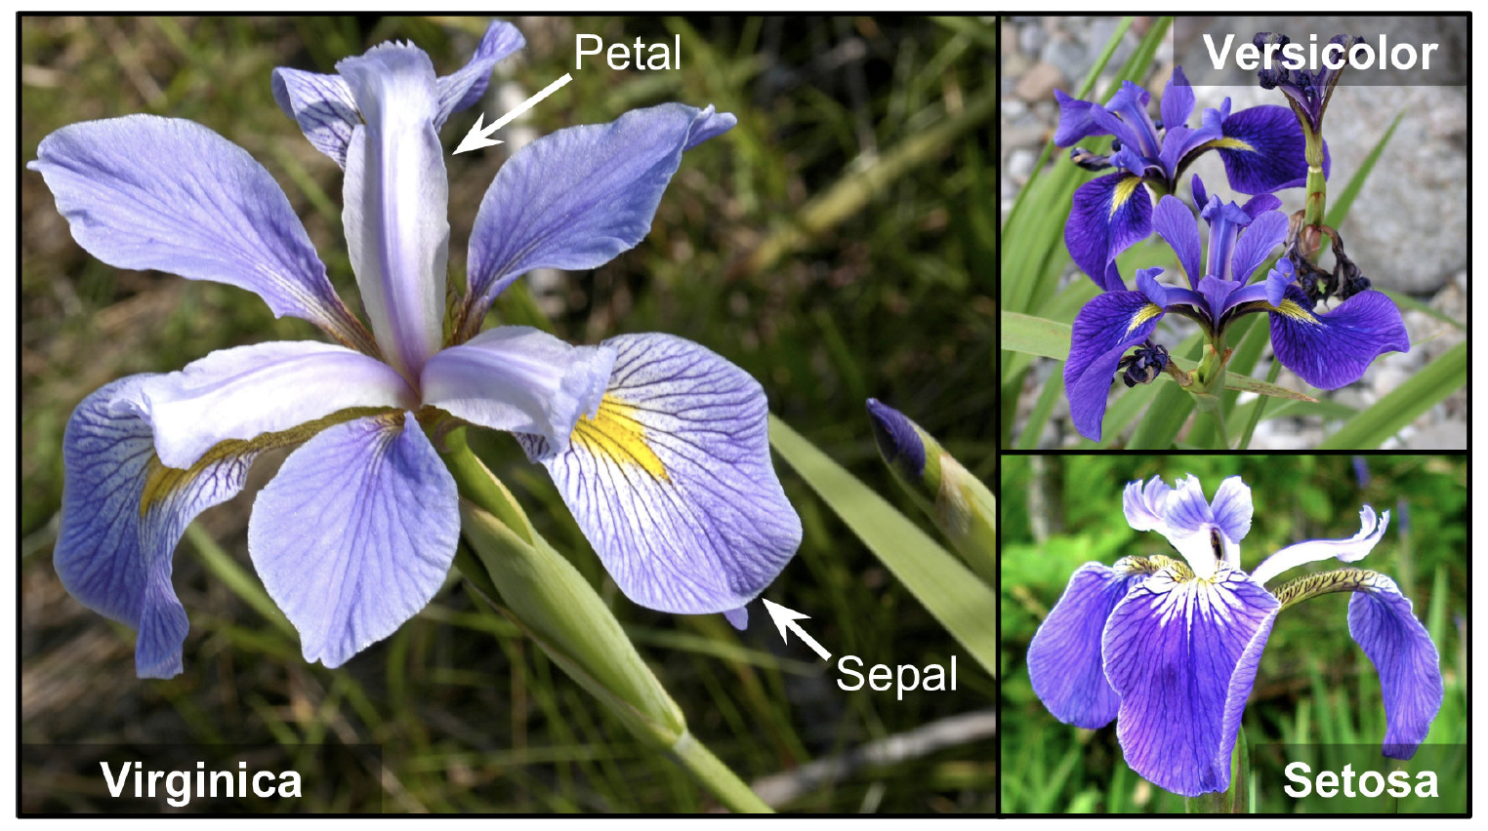
IRIS DATASET
This is a famous dataset that contains the sepal and petal length and width of 150 iris flowers of three different species: Iris-Setosa, Iris-Versicolor, and Iris-Virginica,
We will use this dataset for explaining the basics of traditional ML algorithms, thanks to its simplicity.

Slide 10
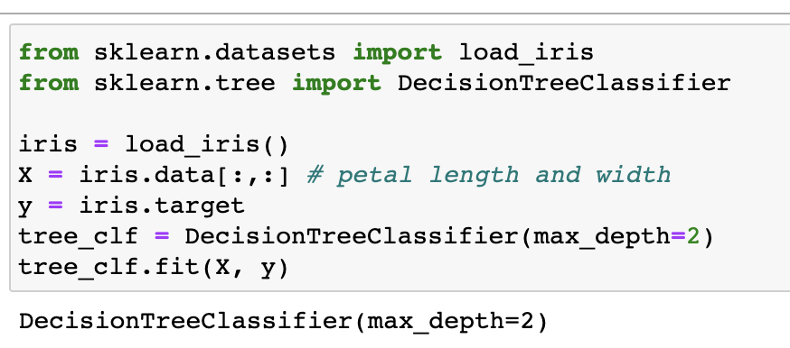
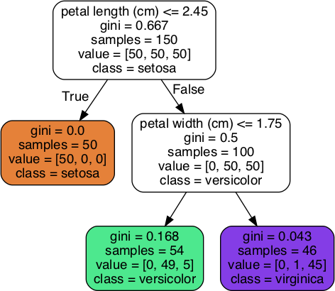
Decision trees
Decision trees are supervised machine learning models which have decision nodes and leaves.
Each leaf represents a category, and the leaves are the decisions or the final outcomes.
The main goal is to create a tree-like structure for predicting the value of a target variable.
Most common forms of decision tree methods are ID3, C4.5, and CART.
Unlike other methods, decision trees require little data preparation, and they can handle both numerical and categorical data

Slide 11
Decision trees
Decision Suppose you find an iris flower and you want to classify it. You start at the root node (depth 0, at the top): this node asks whether the flower’s petal length is smaller than 2.45 cm. If it is, then you move down to the root’s left child node (depth 1, left). In this case, it is a leaf node (i.e., it does not have any children nodes), so it does not ask any questions: you can simply look at the predicted class for that node and the Decision Tree predicts that your flower is an Iris-Setosa (class=setosa).
Now suppose you find another flower, but this time the petal length is greater than 2.45 cm. You must move down to the root’s right child node (depth 1, right), which is not a leaf node, so it asks another question: is the petal width smaller than 1.75 cm? If it is, then your flower is most likely an Iris-Versicolor (depth 2, left). If not, it is likely an Iris-Virginica (depth 2, right). It’s really that simple.

Slide 12
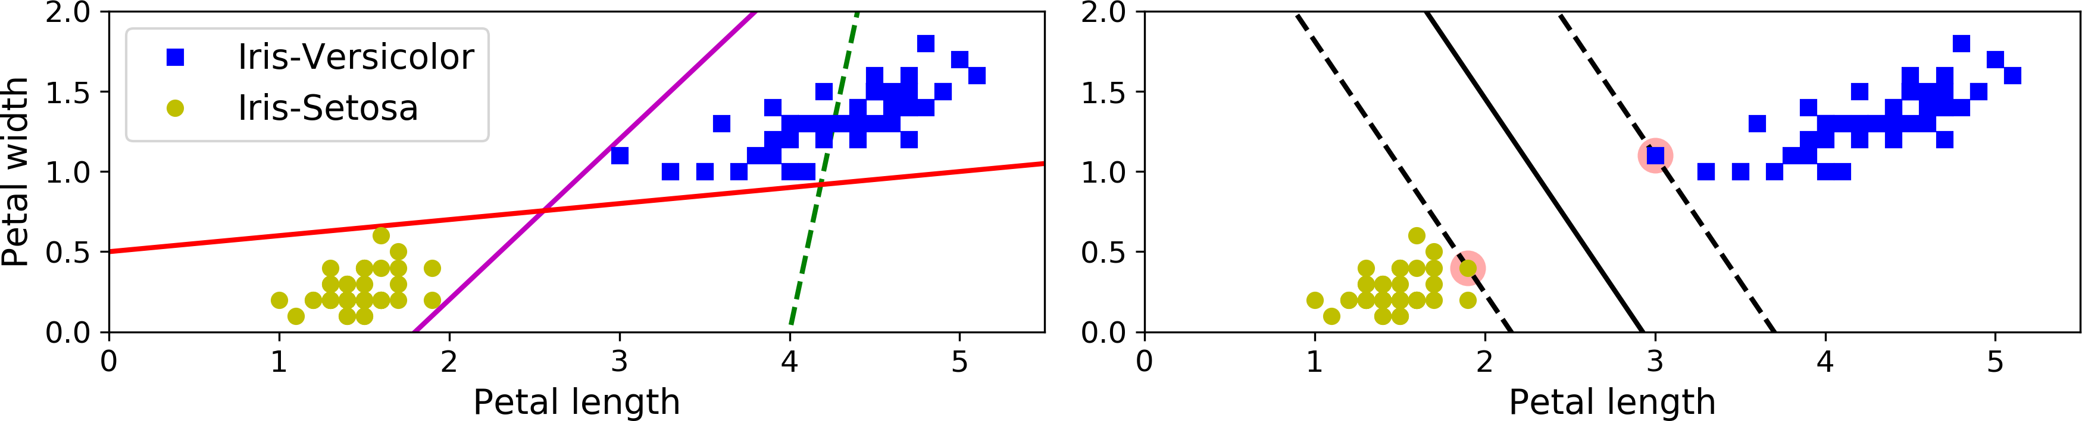
Support vector machines (SVM)
The two classes can clearly be separated easily with a straight line (they are linearly separable).
On the left, the dashed line is so bad even cant separate the two class, Solid lines can separate two classes, but their boundaries is close to each other, so it is prone to make mistakes for predicting new samples located near the boundaries.
On the right, the solid line in the plot on the right represents the decision boundary of an SVM classifier; this line not only separates the two classes but also stays as far away from the closest training instances as possible. You can think of an SVM classifier as fitting the widest possible street (represented by the parallel dashed lines) between the classes. This is called large margin classification.

Slide 13
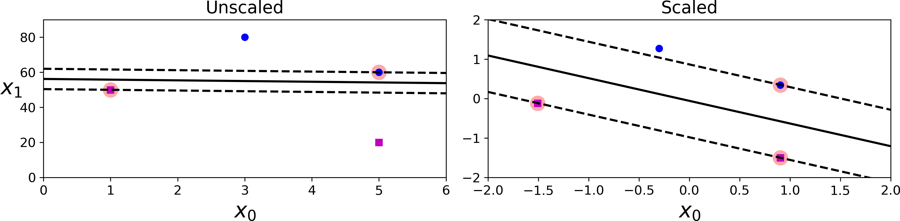
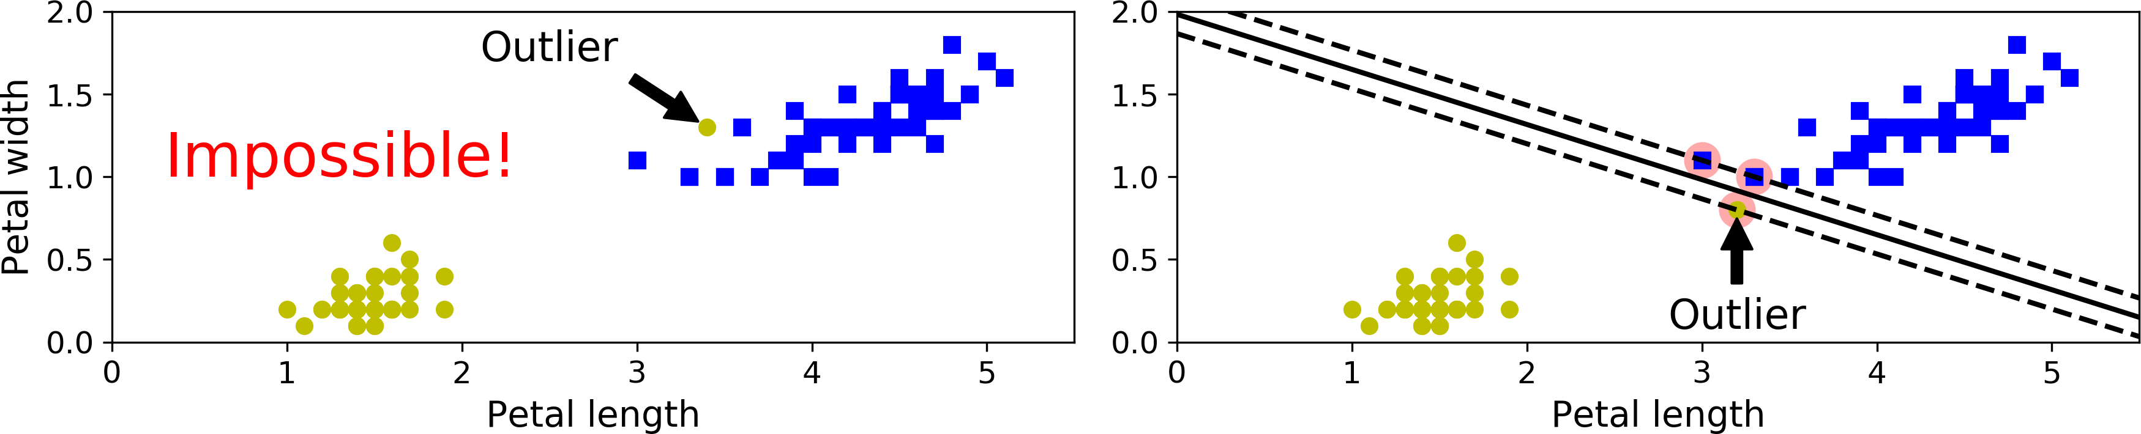
Support vector machines (SVM)
SVMs are sensitive to the feature scales. After feature scaling, the decision boundary looks much better.
If we strictly impose that all instances be off the street and on the right side (hard margin), it is impossible to classify non-linear data.
Using a more flexible model which keeps the street as large as possible and limiting the margin violations (soft margin, there are instances that end up in the middle of the street or even on the wrong side).

Slide 14
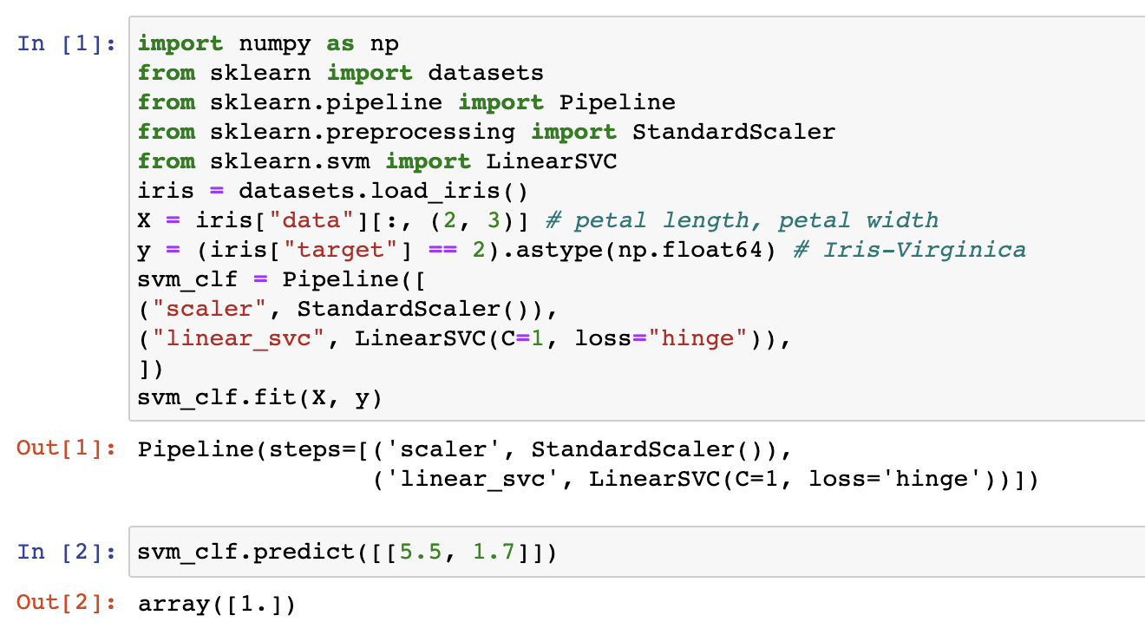
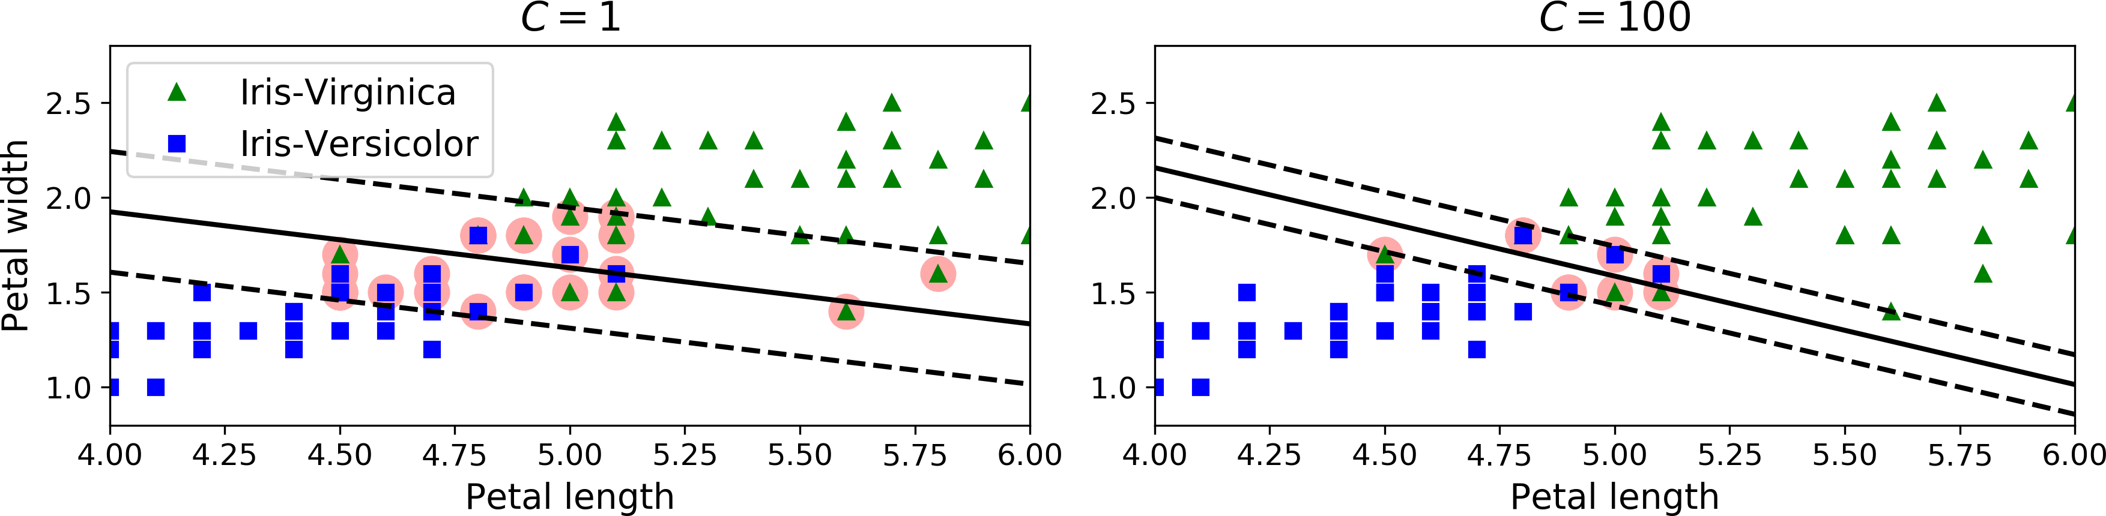
Support vector machines (SVM)
To control the margin violations, you can use scikit-learns SVM classes and C parameter.
A smaller C value leads to a wider street but more margin violations. In the figure, it is seen that the decision boundaries and margins of two soft margin SVM classifiers on a nonlinearly separable dataset.

Slide 15
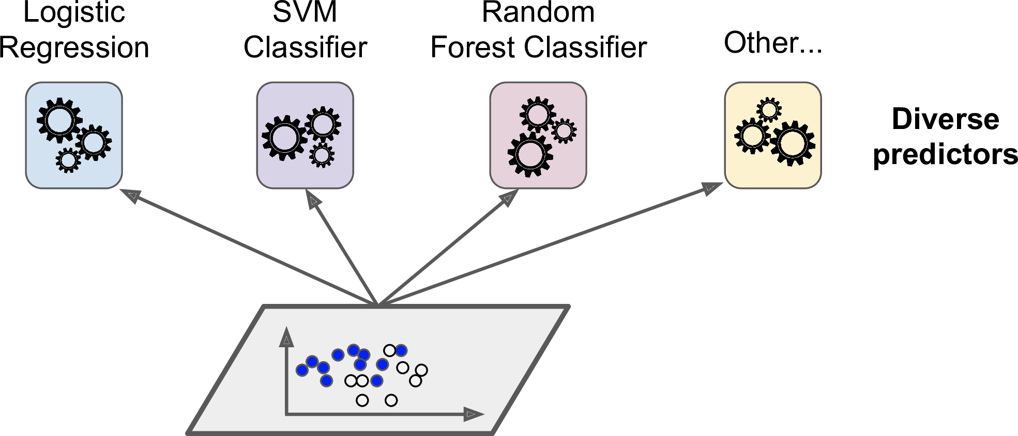
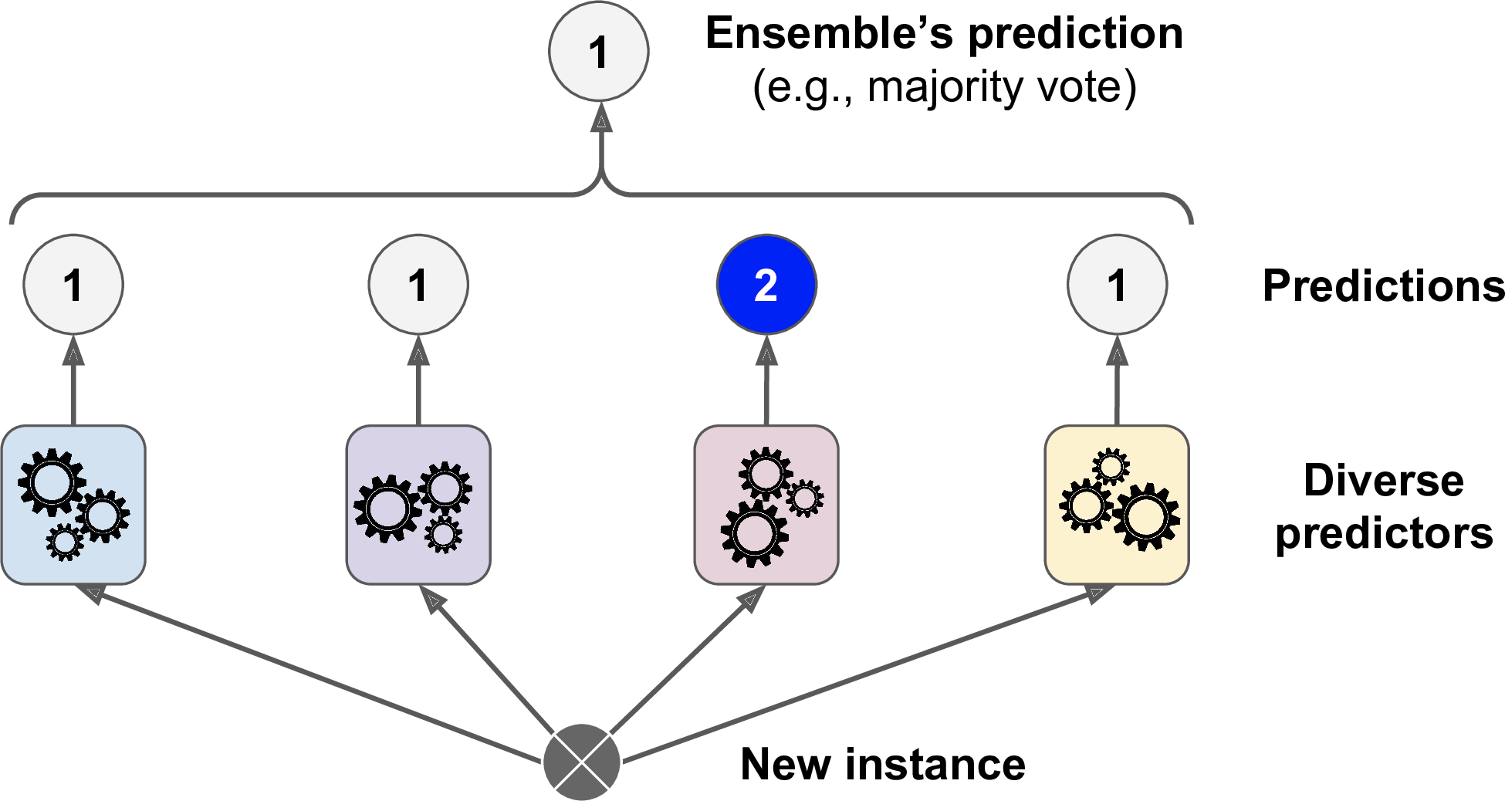
Ensemble learning
This method can be explained by the “Wisdom of the Crowd” since it is making use of the aggregate the predictions of a group of predictors (classifiers or regressors).
Suppose, we’ve trained a few classifiers and aggregate the predictions of each classifier’s prediction by using a majority-vote method (the class/label which gets the most votes).
This is a trade-off between performance and accuracy.

Slide 16
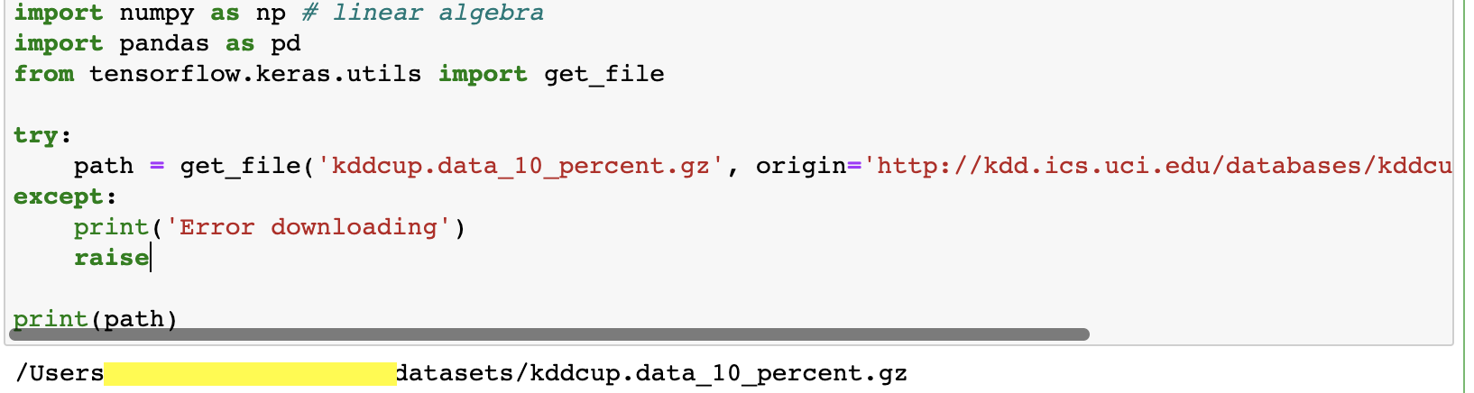
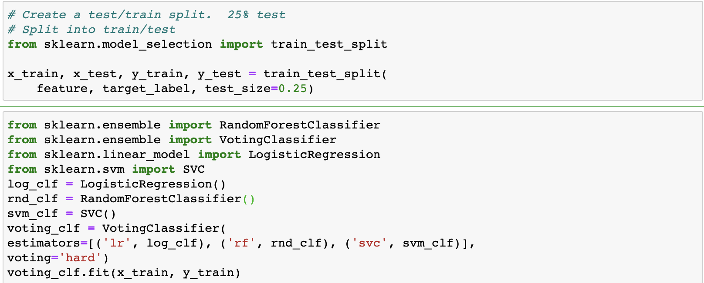
Ensemble learning
The following code creates and trains a voting classifier in Scikit-Learn, composed of three diverse classifiers (the training set is the kddcup dataset, which is introduced in week3 and week4_lab session)
One way to get a diverse set of classifiers is to use very different training algorithms, as discussed before (lab session). Another approach is to use the same training algorithm for every predictor, but to train them on different random subsets of the training set.
When sampling is performed with replacement, this method is called bagging (short for bootstrap aggregating).
When sampling is performed without replacement, it is called pasting.

